Slide 1
PASSWORD PROTECTOR
Andrew Guilbeau
Christopher Sickler
Lei Liu
Christopher Gang

Slide 2
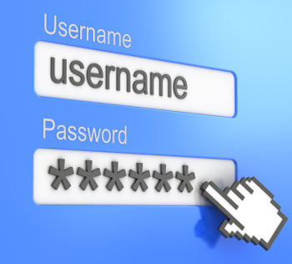
MOTIVATION
Reduce password redundancy
Reduce password theft
Increase password diversity with minimal effort
Generate account passwords

Slide 3

KEY FEATURES
Each log-in will require a key
Password generation is secure
Create, delete and edit accounts
Passwords accommodate user requirements
Passwords have security answers
No internet access required

Slide 4
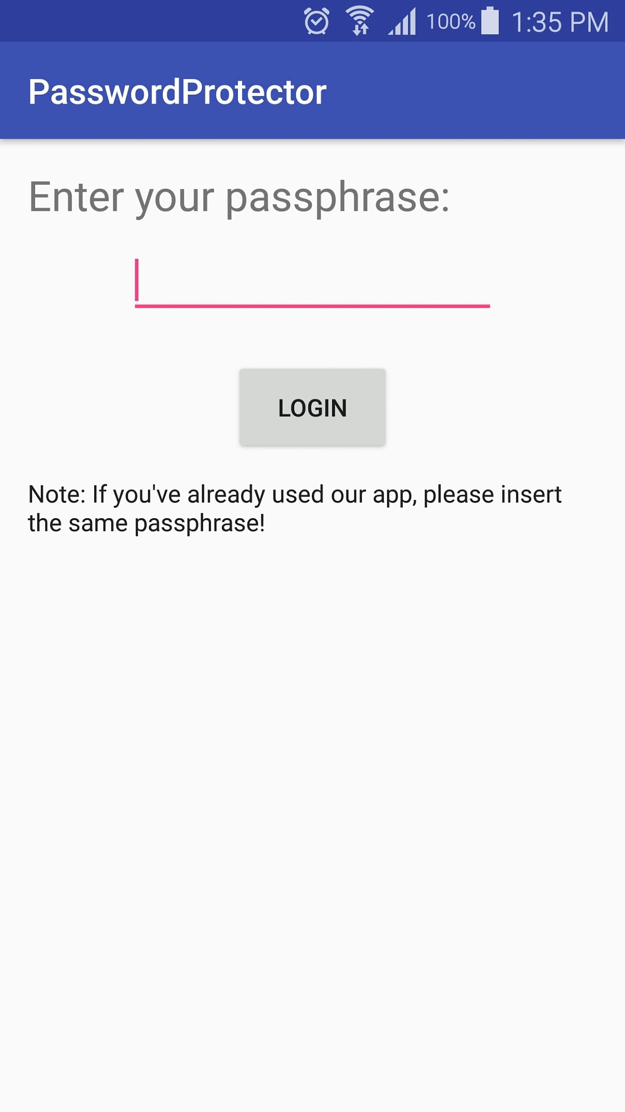
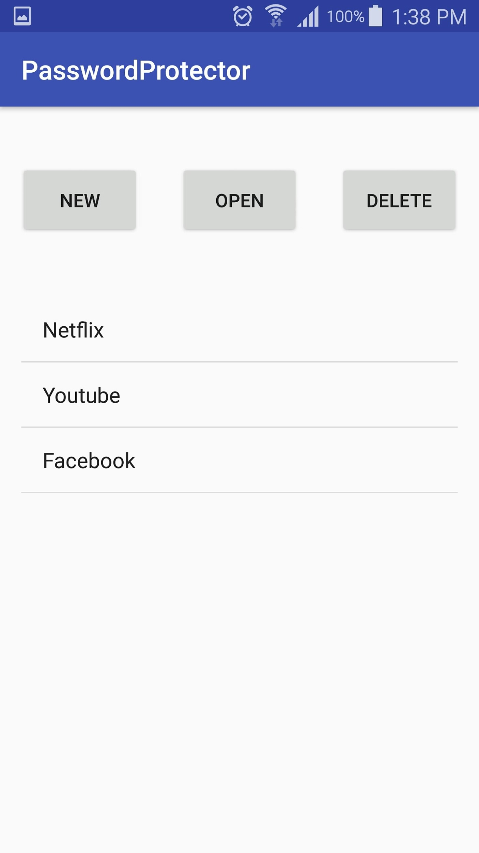
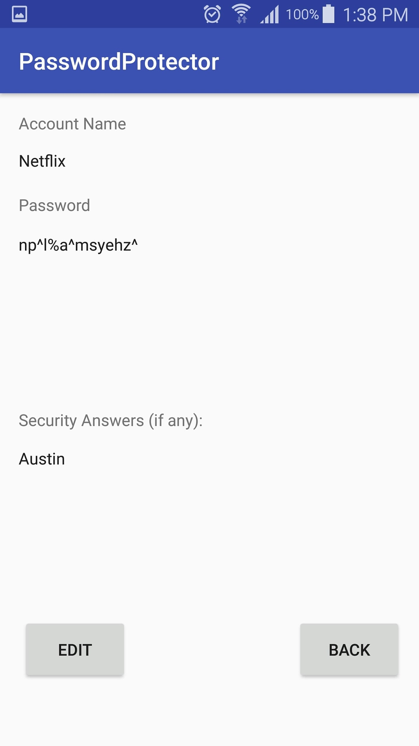
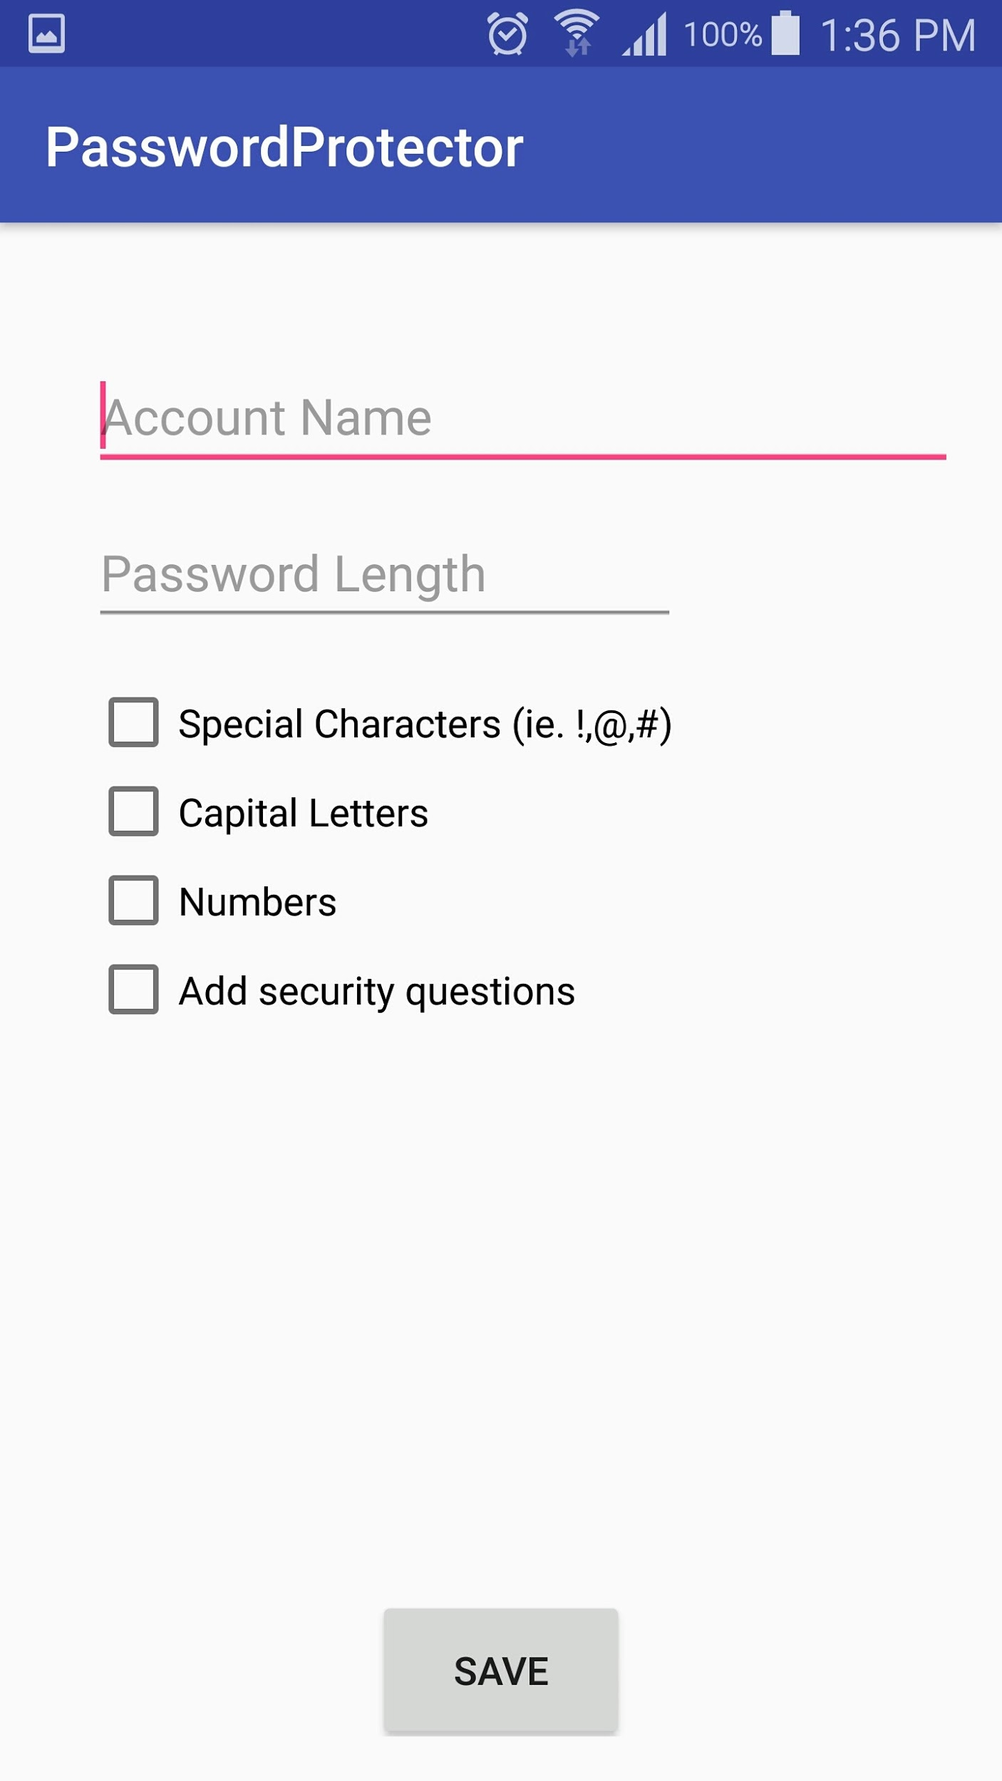
DEMONSTRATION

Slide 5

USER SCENARIOS
If user uses the same password for every account they own
If user uses guest computers constantly (EX: library computers)
User has quick and easy access to many passwords

Slide 6


EXPERIENCES & LESSONS
Android Studio, UI Development
SQL
JUnit testing
UI Testing
Project Management

Slide 7


MARKETING
Free to use
Create Facebook page
Sharing on Facebook
Google App Store
App Store Optimization
Build a website
Send to tech bloggers

